Slide 1
The Theory of Constraints
Applying Theory to Software

Slide 2
Agenda
What Is Constraint Theory?
The Five Focusing Steps
Constraint Theory Applied
Manufacturing
Software Construction
Data Processing
Sources and Discussion

Slide 3
What Is Constraint Theory?
The throughput of a system is constrained by one (or very few) “constraints” – ie, bottlenecks.
From The Phoenix Project:
...any improvements made anywhere besides the bottleneck are an illusion. Astonishing but true! Any improvement made after the bottleneck is useless, because it will always remain starved, waiting for work from the bottleneck. And any improvements made before the bottleneck merely results in more inventory piling up at the bottleneck.

Slide 4
The Five Focusing Steps
Identify the Constraint
Exploit the Constraint
Subordinate Everything to the Constraint
Elevate the Constraint
Avoid Inertia

Slide 5
Constraint Theory Applied - Manufacturing
Identify the Constraint
Exploit the Constraint
Subordinate Everything to the Constraint
Elevate the Constraint
Avoid Inertia

Slide 6
Constraint Theory Applied - Software Construction
Identify the Constraint
Exploit the Constraint
Subordinate Everything to the Constraint
Elevate the Constraint
Avoid Inertia

Slide 7
Constraint Theory Applied - Data Processing
Identify the Constraint
Exploit the Constraint
Subordinate Everything to the Constraint
Elevate the Constraint
Avoid Inertia

Slide 8
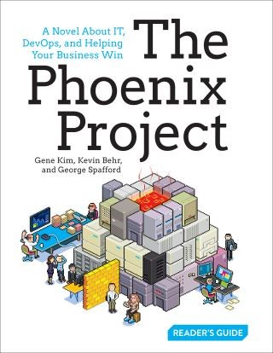
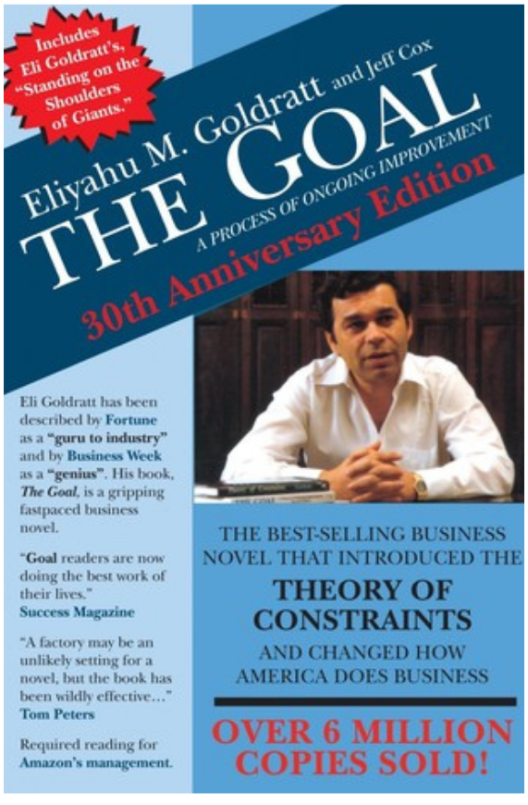
Sources and Discussion
The Phoenix Project – Novel by Kim, Behr, and others covering Constraint Theory in software
Theory of Constraints – The Goal – Article on Medium by Tom Connor
Everything You Need to Know About the Theory of Constraints – Article on Smartsheet by Kate Eby
The Goal – Seminal novel by Eliyahu Goldratt

